Slide 1

Artificial Neural Networks II

Slide 2
Types Of Artificial Neuron Systems
Unsupervised Learning
In unsupervised learning (UL), the system is given only the inputs to learn; the output is unknown to the system. Therefore, the system has to learn or train itself without knowing the final outcome, which is why a UL system does not learn about its performance and the errors.
Reinforcement Learning
In reinforcement learning (RL), the exact output is unknown (as with supervised learning), but we come to know the goodness of a solution.
The system is made to do a set of actions a number of times and receives a reward for every action that it performs. This reward depends on the goodness of the solution.

Slide 3
Radial Basis Function Network
The radial basis function network (RBFN) is another type of ANN that performs unsupervised or supervised learning.
The RBFN uses radial basis functions (RBFs) as activation functions, which allows it to easily solve the problem or perform a mapping of the inputs to outputs.
Concept
RBFNs make use of data known as data centers or data guides, which serve as neurons of the only hidden layer that these networks have. These data centers may be taken from the input data only or from elsewhere in the multidimensional input space. These data centers act as guiding factors for the RBFNs.

Slide 4
Radial Basis Function Network
Network Architecture
The basic architecture of RBFNs is similar to conventional ANNs, which have one hidden layer. The first layer is the input layer, where the inputs are present. The second layer is the only hidden layer in the network. The last layer is the output layer, which gives the final output.
Mathematical Analysis
RBFNs work just like any ANN. The input is applied, and then the various hidden neurons are given the inputs. These neurons perform the summation; then the output is passed through the activation function. The output nodes do the aggregated addition, which generates the system’s final output.

Slide 5
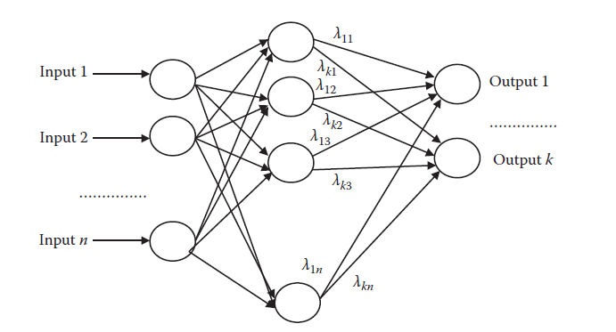
Radial Basis Function Network
The architecture of the radial basis function network.

Slide 6
Radial Basis Function Network
The system’s first task is to find the norm, which is denoted by the function || x ||, by calculating the distance between the applied input and this center. The norm is given in Equation :
hi = ||x − ci ||
where ci is the ith data center or the ith neuron, x is the input, and hi is the aggregated sum.

Slide 7
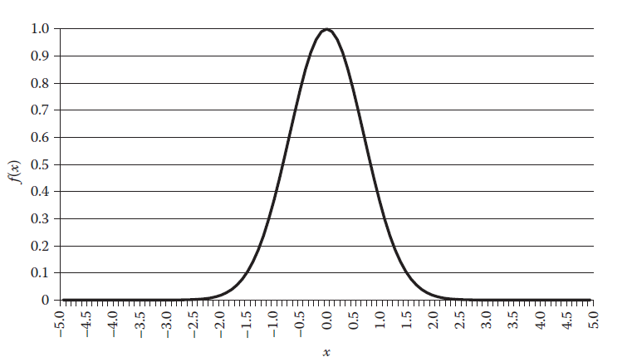
Radial Basis Function Network
The graph of Gaussian function.

Slide 8


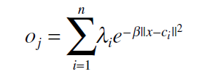
Radial Basis Function Network
The Gaussian function is given by Equation :
The summation hi is passed through the activation function. Hence, using the earlier 2 equations we get :
The output layer simply takes a weighted summation over these inputs, as is represented in Equation :

Slide 9
Radial Basis Function Network
Training
The training in RBFN is done to adjust the various parameters introduced in the mathematical model. The adjustment of these parameters gives the precise network that is able to solve the reallife problem.
In ANN terminology, these parameters comprise the weights between the input layer and the hidden layer and between the hidden layer and the output layer.

Slide 10
Learning Vector Quantization
The learning vector quantization (LVQ) is a means of supervised learning. The LVQ algorithms have a variety of uses in classification problems.
Concept
The general concept of LVQs comes from Hebbian learning, which is an understanding of the human brain and the learning associated with it.
In Human brain ,When an axon of cell A is near enough to excite a cell B and repeatedly or persistently takes part in firing it, some growth processes or metabolic changes take place in one or both cells such that A’s efficiency, as one of the cells firing B, is increased.
For any classification problem, if we know the output at some input, it is natural that the output at the neighboring points would be the same.

Slide 11
Learning Vector Quantization
Architecture
The whole architecture of LVQs consists of three layers: the input layer, the classification layer, and the output layer. The inputs are presented in the input layer.
The classification layer consists of a number of neurons per class. Thus, there need to be an equal number of or more neurons in this layer than the number of classes. The number depends upon the number of neurons used per class, which in turn depends on the ease by which the various classes may be separated. Each neuron has a class associated with it.
Neurons represent regions where the class possibly lies. The neurons may be visualized as the subclasses of every class. Each class has one or more subclasses, and similarly these networks have one or more neurons per class.

Slide 12

Learning Vector Quantization
Mathematical Modeling
Suppose that an input i has been applied. The LVQ begins by calculating the distance of this input I from all the other neurons that are present in the second layer. This distance, also called the norm.
This norm is given in Equation :
where ai 1 is the distance between the input and the ith neuron. The weight Wi 1 is the position of the neuron.

Slide 13


Learning Vector Quantization
The next task is to find the neuron, or guide, that lies closest to this input in the input space :
The activation function simply selects the minimum distance of all ai
Once the neuron that lies closest to the input is known, we need to find the class that corresponds to this neuron. This class is the system’s final output.
The weight matrix W 2 of this layer is a mapping between the subclasses and the classes. The columns in the matrix represent the subclasses, and the rows represent the classes.
The final answer is the class that has the minimum distance, and this is the output of the entire network.

Slide 14
Learning Vector Quantization
Training
Training in an LVQ has two phases. In the first phase, we calculate the correct neuron that is activated whenever an input is applied.
The second phase is the modification of the parameters, or weights, of the LVQ. The parameters are in the form of the positions of the various neurons, or guides. The weights are modified to make the network move in a direction such that the error is reduced.
LVQ 1 Algorithm
In this algorithm, only the winning neuron is modified; no change made to any other neuron.
The modified neuron moves toward the input or away from the input, depending on the condition.

Slide 15



LVQ 1 Algorithm
Suppose the network identified the output class correctly. In this case, the strategy is to move the winning neuron more toward input i. This is achieved by adding a small parameter in the direction of the input, as represented by Equation :
If, however, the network does not identify the class correctly, we try to move the weight of the winning neuron a little away from input i, as shown in Equation :
For the other neurons that are not the winning neurons, the weight remains unchanged, as shown in Equation :

Slide 16

LVQ 2.1 Algorithm
This algorithm modifies two neurons in place of one. Out of these two neurons, one belongs to the correct class and the other to the wrong class.
In addition, input i for this algorithm must lie within the window formed between the midplanes of the two selected closest neurons. Let w denote the width of this window.
Let j and k denote the neurons to be modified . Let the distance of input i to neurons j and k be dj and dk, respectively.
We say that input i falls in a window of width w if this Equation holds :

Slide 17

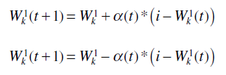
LVQ 2.1 Algorithm
where s is given by Equation :
The modification of the weights is given by Equations :

Slide 18
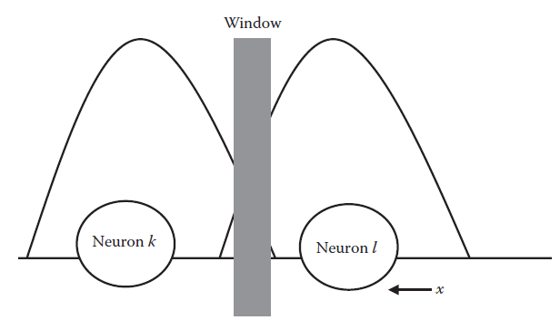
LVQ 2.1 Algorithm
The window in the learning vector quantization 2 learning algorithm.

Slide 19
Self Organizing Maps
The self-organizing map (SOM) is quite similar to the LVQ. SOMs are used for learning in an unsupervised mode. In this mode, the inputs are known, but the outputs are unknown.
Concept
SOMs, which are used for unsupervised learning, make use of the concept of feature maps. The entire high-dimensional input data can be mapped on a two-dimensional map called the feature map. In this map, the closer regions are closer in the high-dimensional input space and vice versa.
Each node in this feature map represents some point in the input space. In this feature map, the neighboring points of a point p are the points that lie close to it.

Slide 20
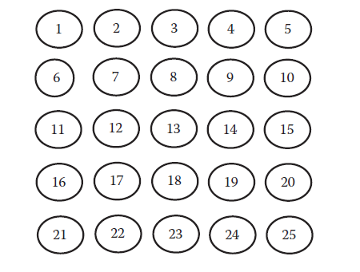
Self Organizing Maps
Architecture
The SOM has a simple two-layer architecture. The first layer is the input layer, which is where an input is applied. The second layer is the classifying layer. This layer consists of the feature map, also known as the self-organizing feature map (SOFM), which comprises a set of neurons that are usually arranged in a two-dimensional matrix.
The self-organizing feature map.

Slide 21


Self Organizing Maps
Mathematical Analysis
The concept of SOM’s mathematical framework is the same as that of the LVQ. The first step in the SOM is to compute the neuron that lies closest to the given input. This is done by calculating the norm given in Equation :
where Wi represents the weight, or the position, of the ith neuron in the input space And ai is the output of the ith neuron.
The class corresponding to the output class of the winning neuron a is regarded as the final network output.

Slide 22


Self Organizing Maps
Training
The SOM’s training procedure consists of calculating the class that corresponds to the network and modifying the network’s parameters, or weights.
Modification of the winning neuron’s weight at any time t is given by Equations :
where Wk represents the weight, or position, of the kth neuron in the input space, t is time, and i is input.

Slide 23


Self Organizing Maps
We change the weights not only of the winning neuron but also of the neighboring neurons according to Equations of previous slides.
Neighboring neurons are defined as those neurons that lie within a certain predefined radius r of the winning neuron, as given in Equation :
where N(r) denotes the neighboring neurons, j denotes the winning neuron, and djk denotes the distance of neuron k from neuron j.
The parameter h(t), given by Equation :

Slide 24
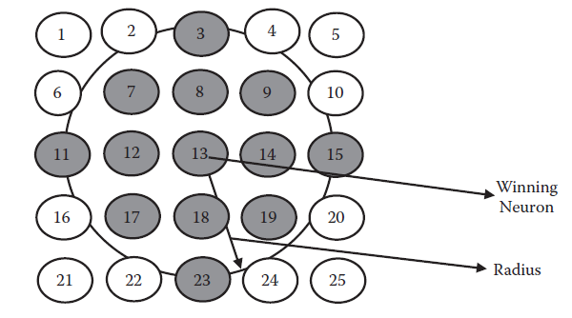
Self Organizing Maps
The neighborhood of the winning neuron in self-organizing maps.

Slide 25
Recurrent Neural Network
Recurrent neural networks are a special type of ANN in which the output of one or more neurons is fed back into the network as inputs, forming the input for the next iteration. These networks offer a good means of machine learning in which past outputs may potentially affect the next outputs.
Concept
Because recurrent neural networks have additional inputs that come from the output of the neurons, they are also known as time delay networks. This means that the output of any neuron at time t is the input given to the system at time t + 1.
The additional inputs given to the system help better adapt the system for certain problems, such as series prediction, functional approximation, and recognition systems.

Slide 26
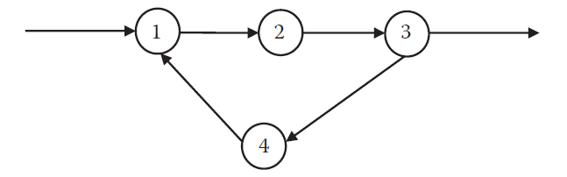
Recurrent Neural Network
Architecture
The architecture of these networks is similar to that of the ANNs. In conventional ANNs, however, neurons connect one layer to the next layer, with no evidence of an internal cycle being formed. The existence of cycles is possible in recurrent neural networks. The existence of cycles implies that the information keeps cycling between the neurons.
The cycle in the recurrent artificial neural network.

Slide 27
Recurrent Neural Network
These networks usually have outputs that are reintroduced to the system as inputs. The final output of a system at a time t becomes the input of the system at a time t + 1.
Training
The training of these networks is similar to the training in conventional ANN training. The standard back propagation algorithm may be used for the training of these networks. Training involves calculation of outputs, determination of error, and back propagation of error to preceding layers to adjust for weights and biases.

Slide 28
Hopfield Neural Network
Hopfield neural networks take their inspiration from the feedback system in biological neurons, in which continuous feedback from the various nodes helps guide the output of the systems.
There are two types of Hopfield neural networks: the binary Hopfield neural network and the continuous Hopfield neural network.
The binary Hopfield neural network has binary outputs that are either 0 or 1.
The continuous Hopfield network, on the other hand, has outputs that can be any value between 0 and 1.

Slide 29
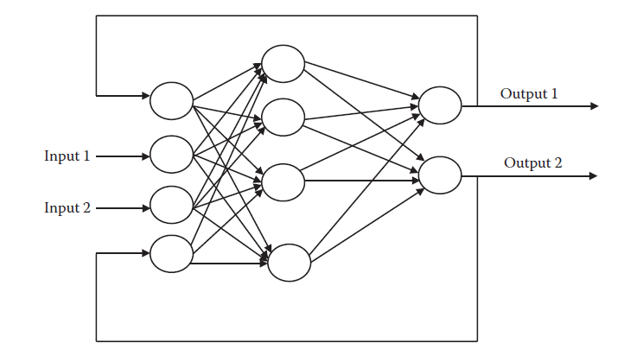
Hopfield Neural Network
The architecture of the recurrent artificial neural network.

Slide 30
Hopfield Neural Network
Concept
The basic concept in these networks is that of feedback. Every neuron is provided with feedback from the other neurons. These feedbacks are incorporated while calculating the output of any of the neurons.
Thus, in Hopfield nets, the final output of any one neuron is the summation of the input plus the feedbacks from the various neurons.
Architecture
In general, the architecture of these networks is the same as that of any ANN. The difference, however, lies at the level of the neuron architecture.
The neurons in these networks are fitted with extra internal inputs in the form of feedbacks from the various other neurons. The past outputs of these neurons are used as inputs in the subsequent times.

Slide 31
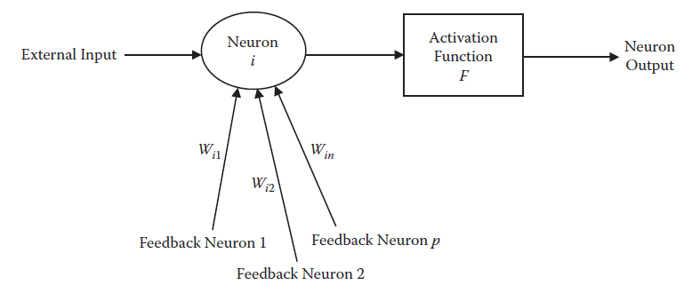
Hopfield Neural Network
Each neuron i has a feedback input weight wij that comes from any other neuron j. Any neuron does not give feedback to itself (in other words, wii = 0). The final summation is performed and passed to the activation function.
The structure of a neuron in a Hopfield neural network.

Slide 32

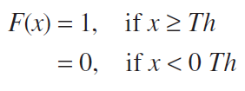
Hopfield Neural Network
Mathematical Modeling
This section discusses the mathematical formulation of the Hopfield ANN. The input to any neuron is given by Equation :
where yj denotes the output of the neuron j at any time t, Wij is the associated weight, and Ii denotes the external inputs given to the system.
Output Zi passes through the activation function F(x). The activation function for a binary Hopfield network is given by Equation :

Slide 33
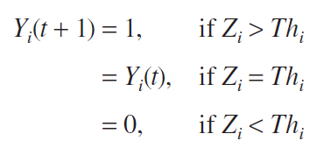
Hopfield Neural Network
where Th denotes the threshold. The result of the activation function is given in Equation :
This is the output of the neuron.

Slide 34
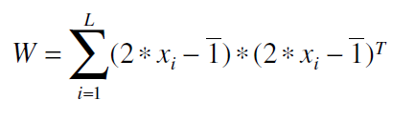
Hopfield Neural Network
Training
The Hopfield neural networks do not need separate training methods. The entire procedure of adjusting weights can be done by having a look at the inputs themselves. The equation of the weight matrix W in the Hopfield neural network is given by Equation :

Slide 35
Adaptive Resonance Theory
Adaptive resonance theory (ART) was proposed to cope with the problem of forgetting. ANNs are prone to forget previously learned rules when they are not revised for a long time, even as the ANN continues to learn newer rules.
Concept
The problem of learning new patterns without forgetting the older ones is called plasticity. The need for plasticity arises when we need to learn many patterns over time. ANNs usually tend to forget older patterns as they are exposed to newer ones, which leads to problems in recognizing older patterns.
ART networks are unsupervised neural networks that employ neurons to map the inputs to outputs. Each neuron represents some point in the input space.

Slide 36
Adaptive Resonance Theory
Architecture
The architecture of the ART consists of two major layers. The inputs are given to the first layer, and the classified output may be collected from the second layer. Processing takes place between these two layers.
The first layer, where inputs are applied, is also called the comparison layer (for reasons discussed later). The weights between the two layers are responsible for the network’s entire memory.
The second layer is also called the recognition layer or the competitive layer. This layer does the work of recognition or classification. It selects only one class—the class that has the largest match according to the inputs given to the layer.

Slide 37
Adaptive Resonance Theory
Training
The training of the ART consists of passing the inputs one by one to the network and modifying the weight or the prototype vector. The basic motivation is the same as for any classifying network in which we try to move a network so that it performs well the next time the same input is given.
In ART, the inputs are first applied at the input layer. The weights are multiplied by the inputs and passed from the first layer to the second. The output goes to the second layer, which is the classification layer.
Here the outputs are decided according to their closeness. Only one class is decided, and it is regarded as the final class.

Slide 38
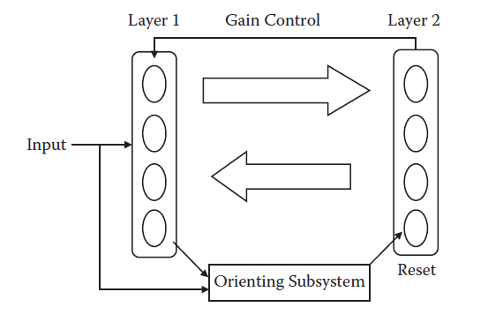
Adaptive Resonance Theory
Basic adaptive resonance theory (ART) network architecture.

Slide 39
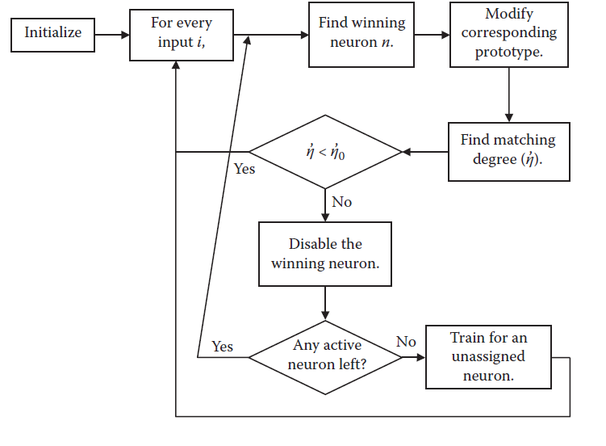
Adaptive Resonance Theory
The learning algorithm in ART networks.

Slide 40
Character Recognition By Commonly Used ANNS
Problem Description
Character recognition identifies the character. The character may be obtained from scanned documents, embedded images, or real-time scanning such as the input from a connected pen.
Character recognition is essentially studied in two separate heads: offline character recognition and online character recognition.
The problem with character recognition, as with any recognition system, involves preprocessing, segmentation, feature extraction, and recognition.

Slide 41
Character Recognition By Commonly Used ANNS
Inputs
Let us take as the input the entire image.
Testing has been done on a separate testing data, which were generated by occultation of reversal of some bits in the training data.
M x N inputs are given to the system, where M and N are the dimensions of the image. Each pixel is represented by one input. Every input is either 0 or 1, depending on the presence of ink at that point. The size is taken as 6 x 6 for optimal training
Outputs
The issue is to correctly identify the class to which any input belongs. The system will then give a single output to every system. This is the class to which the input belongs, or the identified character.

Slide 42
Character Recognition By Commonly Used ANNS
Solution by Radial Basis Function Network
The first algorithm we used to recognize the input character was RBFN. The inputs were given to the RBFN, the outputs were numbered 1 to 10 for every character, and the network was created.
We found that the network showed 100 percent accuracy in both testing and training data.
Solution by Learning Vector Quantization
The next algorithm used was the LVQ. We found that the network again showed 100 percent accuracy in both testing and training data. The total number of neurons in the hidden layer was fixed to 5. A learning rate of 0.01 was used. The learning function used was learnlv1. The goal was 10–3, and the epochs were 1000.

Slide 43
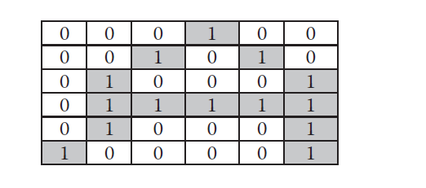
Character Recognition By Commonly Used ANNS
Input corresponding to letter A.

Slide 44
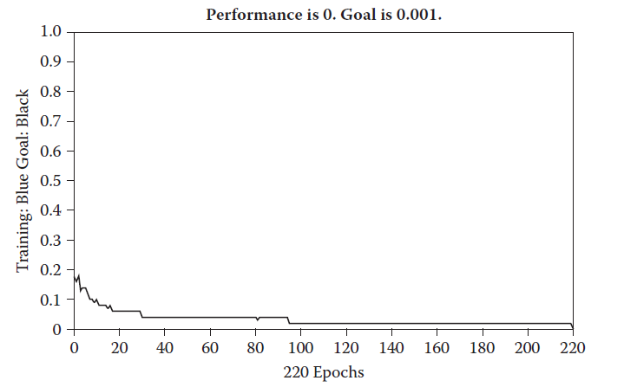
Character Recognition By Commonly Used ANNS
The training curve for learning vector quantization (LVQ).

Slide 45
Character Recognition By Commonly Used ANNS
Solution by Self-Organizing Map
The next algorithm applied was SOM. We again found that the network showed 100 percent accuracy in both testing and training data. In this case, the codebook used for the SOM was of dimension 4 x 4. The network was trained for 1000 epochs.
Initially all the weights were at the center of the input space, but they moved apart as the training continued.
The result on the test of occultation was again found to be the same.

Slide 46
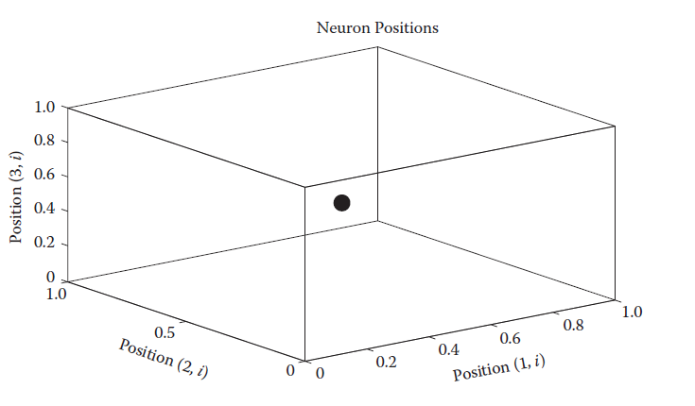
Character Recognition By Commonly Used ANNS
The initial placement of weights in LVQ before training (Only three dimensions are shown.).

Slide 47
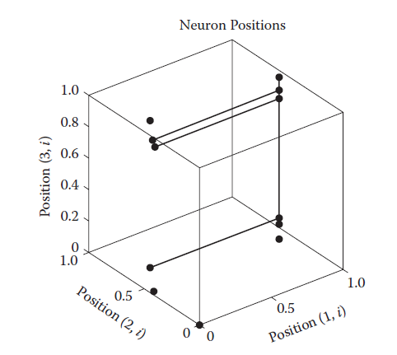
Character Recognition By Commonly Used ANNS
The placement of weights in LVQ after training (Only three dimensions are shown.).

Slide 48
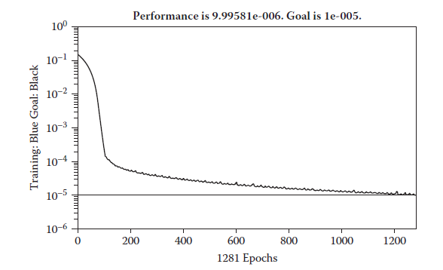
Character Recognition By Commonly Used ANNS
To the same problem and inputs, we applied Hopfield neural networks. Matlab was used as a platform. We again found that the network showed 100 percent accuracy in both testing and training data. We observed that the Hopfield neural network stabilized at the input points given to it for training.
The training curve for recurrent Elman networks.

